Slide 1
INFO6003 Lab-08 (You might not need all 10 slides)
Sudip Pokhrel
1072933

Slide 2
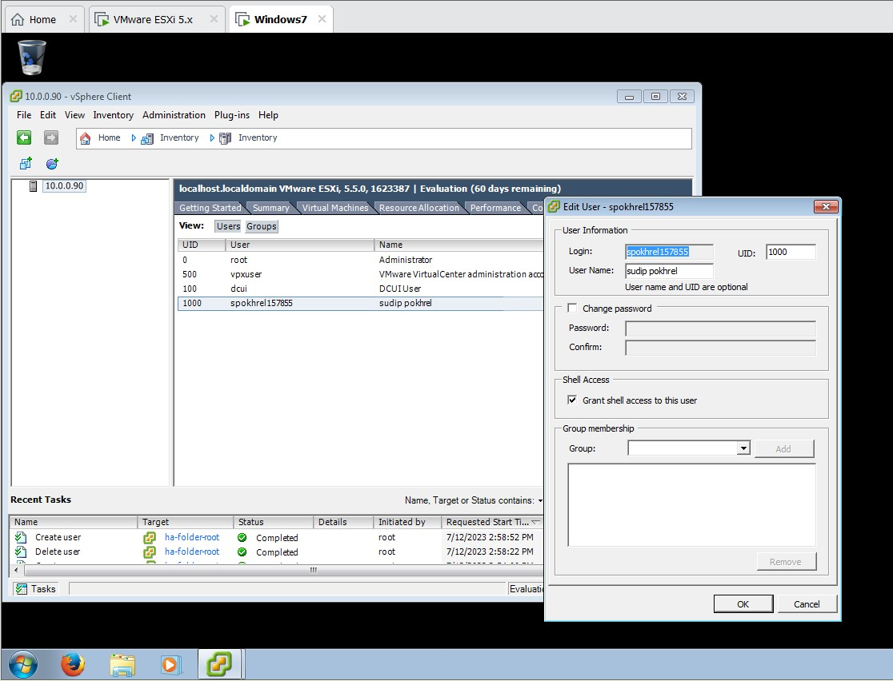
Slide #1

Slide 3
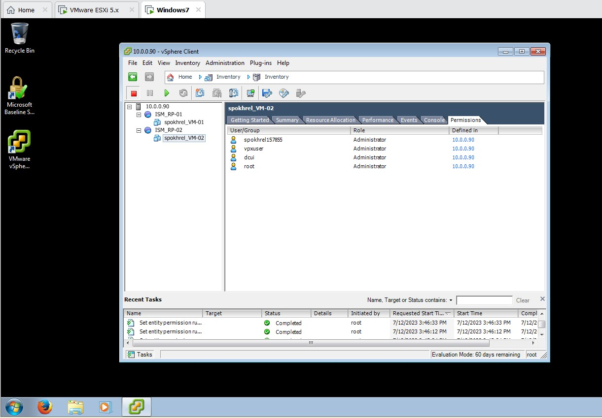
Slide #2

Slide 4
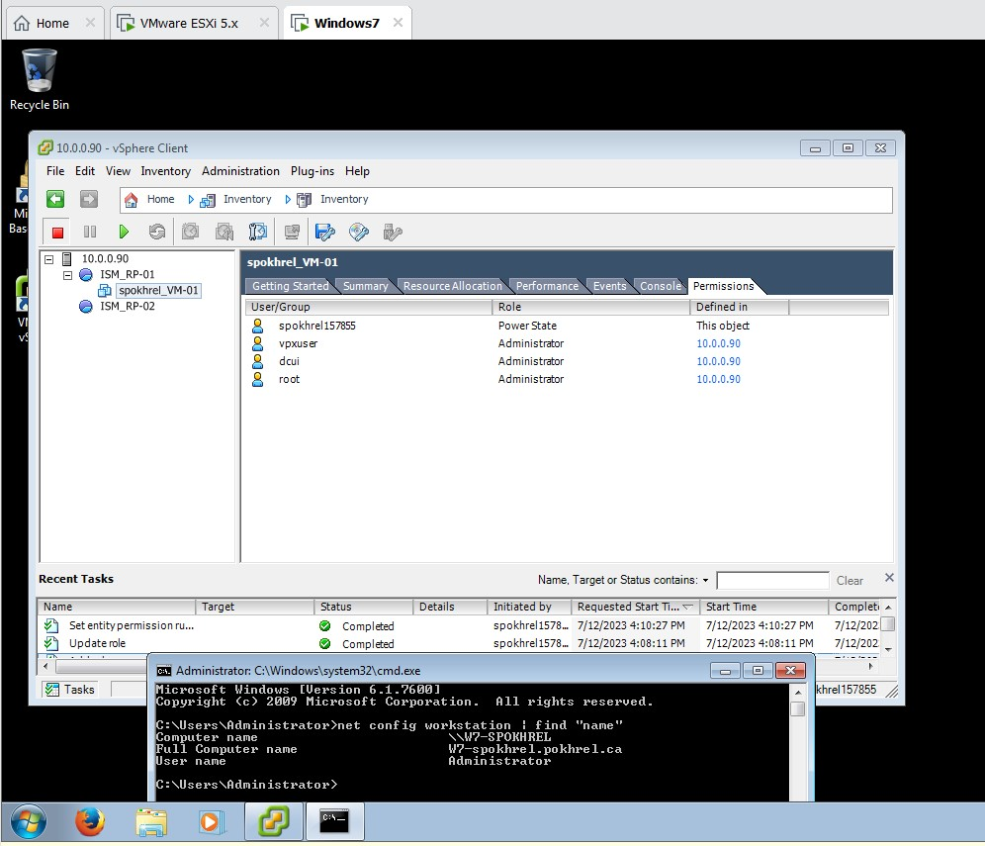
Slide #3

Slide 5
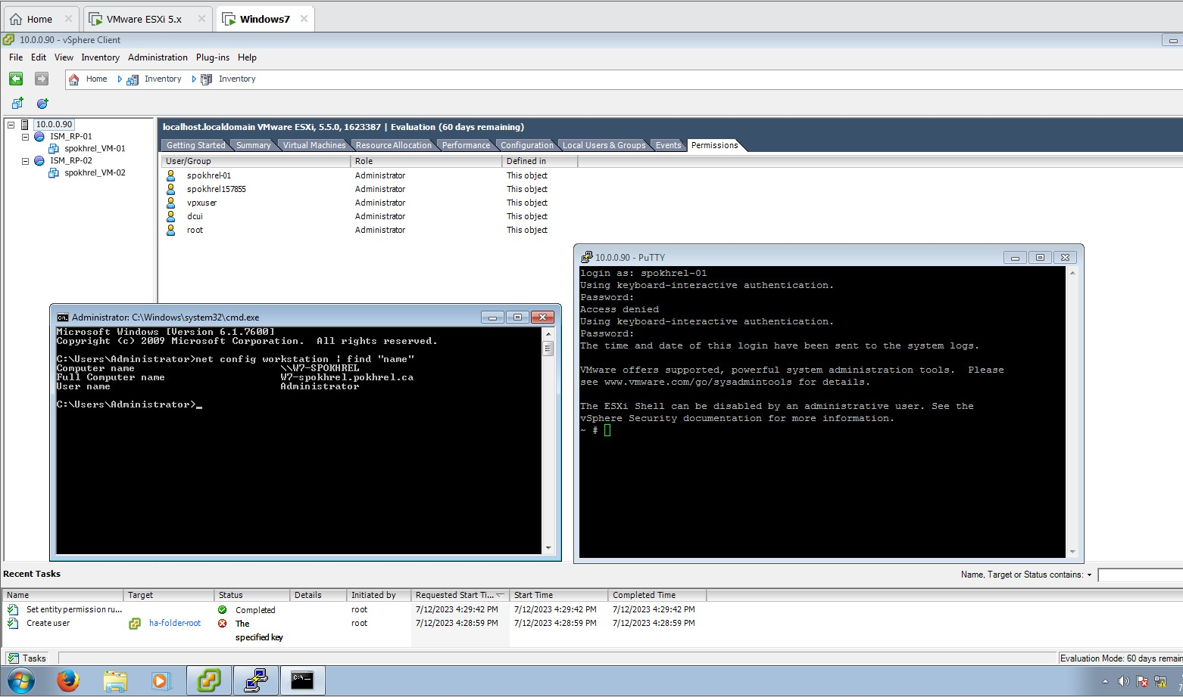
Slide #4

Slide 6
Slide #5
Why do we like using LAN segments? LAN segments are popular because they increase network performance, segregate broadcast traffic, improve security, simplify network management, provide scalability, enable isolated faults, and provide Quality of Service (QoS) techniques. Why did this fail? As propagation is remove from ISM_RP-01S

